Slide 1
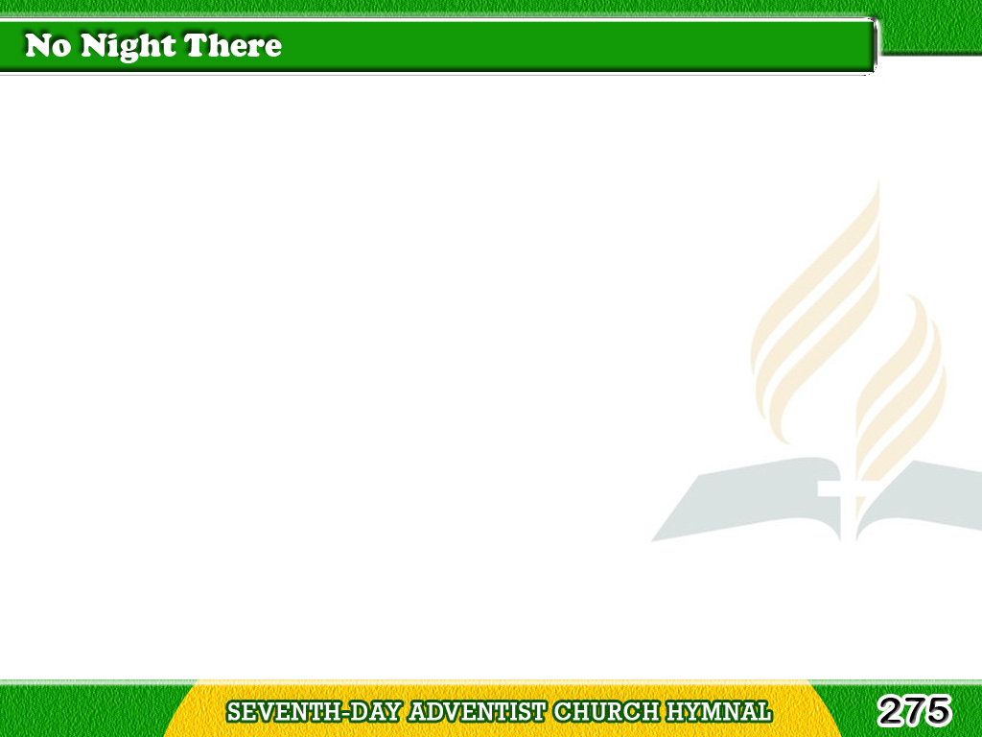
1/4
In the land of fadeless day
Lies “the city foursquare;”
It shall never pass away,
And there is “no night there.”
Tagalog
Version

Slide 2
1/4
Chorus
God shall
“wipe away all tears;”
There’s no death,
no pain, nor fears;
Tagalog
Version

Slide 3
1/4
Chorus
And they count
not time by years,
For there is
“no night there.”
Tagalog
Version

Slide 4
2/4
All the gates of pearl are made,
In “the city foursquare;”
All the streets with gold are laid,
And there is “no night there.”
Tagalog
Version

Slide 5
2/4
Chorus
God shall
“wipe away all tears;”
There’s no death,
no pain, nor fears;
Tagalog
Version

Slide 6
2/4
Chorus
And they count
not time by years,
For there is
“no night there.”
Tagalog
Version

Slide 7
3/4
And the gates shall never close
To “the city foursquare;”
There life’s crystal river flows,
And there is “no night there.”
Tagalog
Version

Slide 8
3/4
Chorus
God shall
“wipe away all tears;”
There’s no death,
no pain, nor fears;
Tagalog
Version

Slide 9
3/4
Chorus
And they count
not time by years,
For there is
“no night there.”
Tagalog
Version

Slide 10
4/4
There they need
no sunshine bright,
In “that city foursquare,”
For the Lamb is all the light,
And there is “no night there.”
Tagalog
Version

Slide 11
4/4
Chorus
God shall
“wipe away all tears;”
There’s no death,
no pain, nor fears;
Tagalog
Version

Slide 12
4/4
Chorus
And they count
not time by years,
For there is
“no night there.”
Tagalog
Version

